Slide 1
Human Computer Interaction
Project:
Eye tracking & Keyboards
David Katalinić & Filip Jovanović

Slide 2
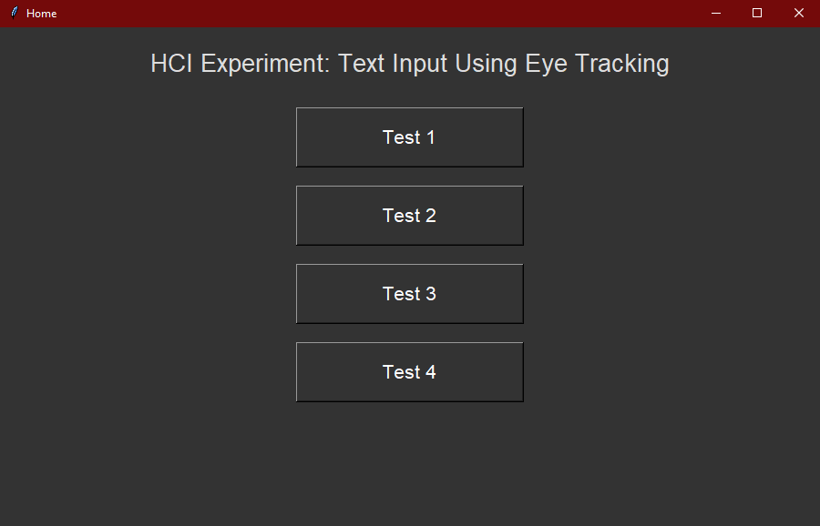
Application look and how it works
Independent variables, 2 levels each:
Eye controlled input:
Left and right input
Free roam input
Type of onscreen keyboard layout:
QWERTY keyboard
Quadrant keyboard
Home screen with test options:
Test 1 -> Left-right input and quadrant keyboard
Test 2 -> Left-right input and qwerty keyboard
Test 3 -> Free roam input and quadrant keyboard
Test 4 -> Free roam input and qwerty keyboard
Two dependent variables:
WPM (words per minute)
TER (total error rate)

Slide 3
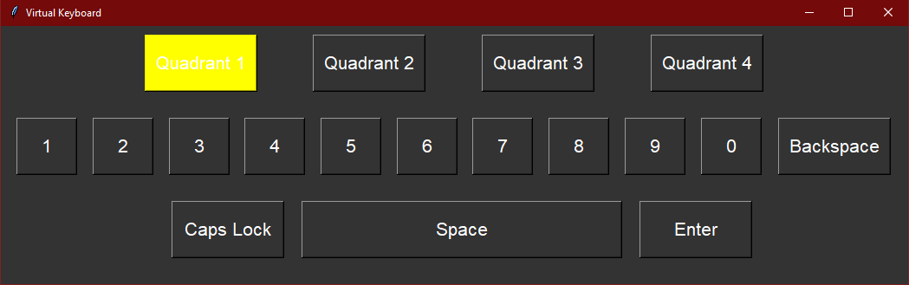
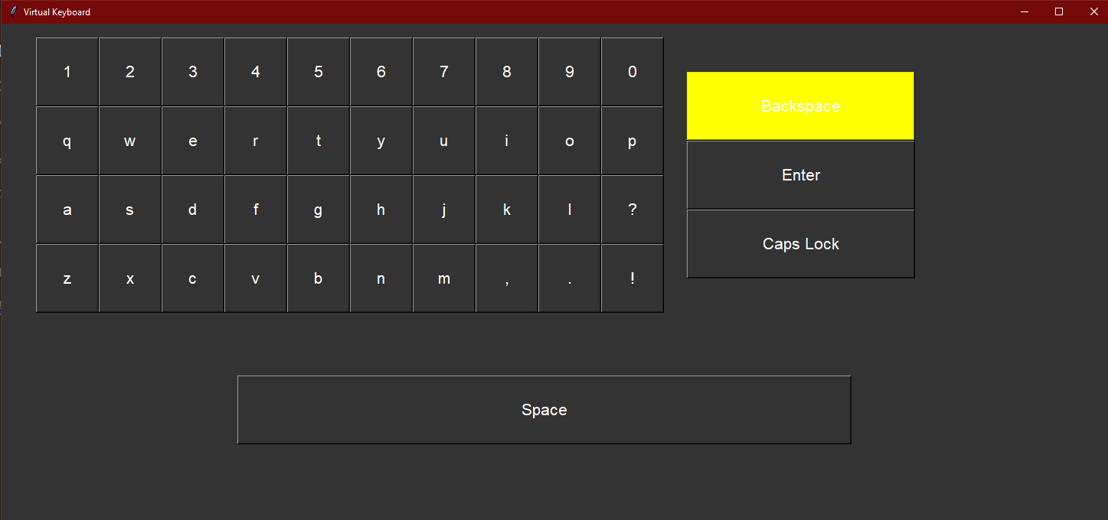
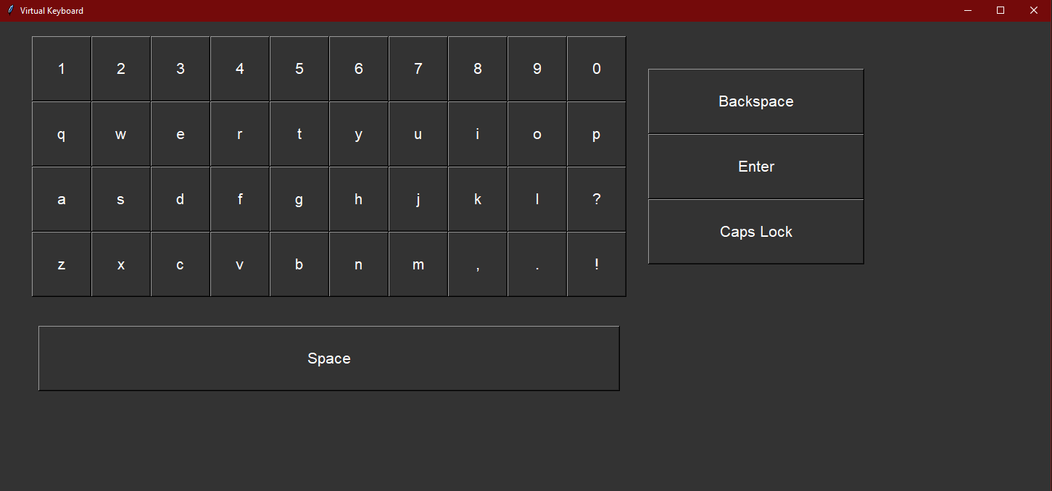
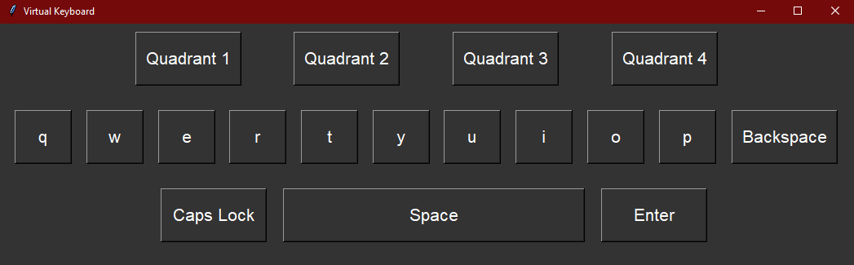
Different inputs and keyboard layouts
(1)Left-right, (2)Free roam
Quadrant layout
Qwerty layout
1
1
2
2

Slide 4
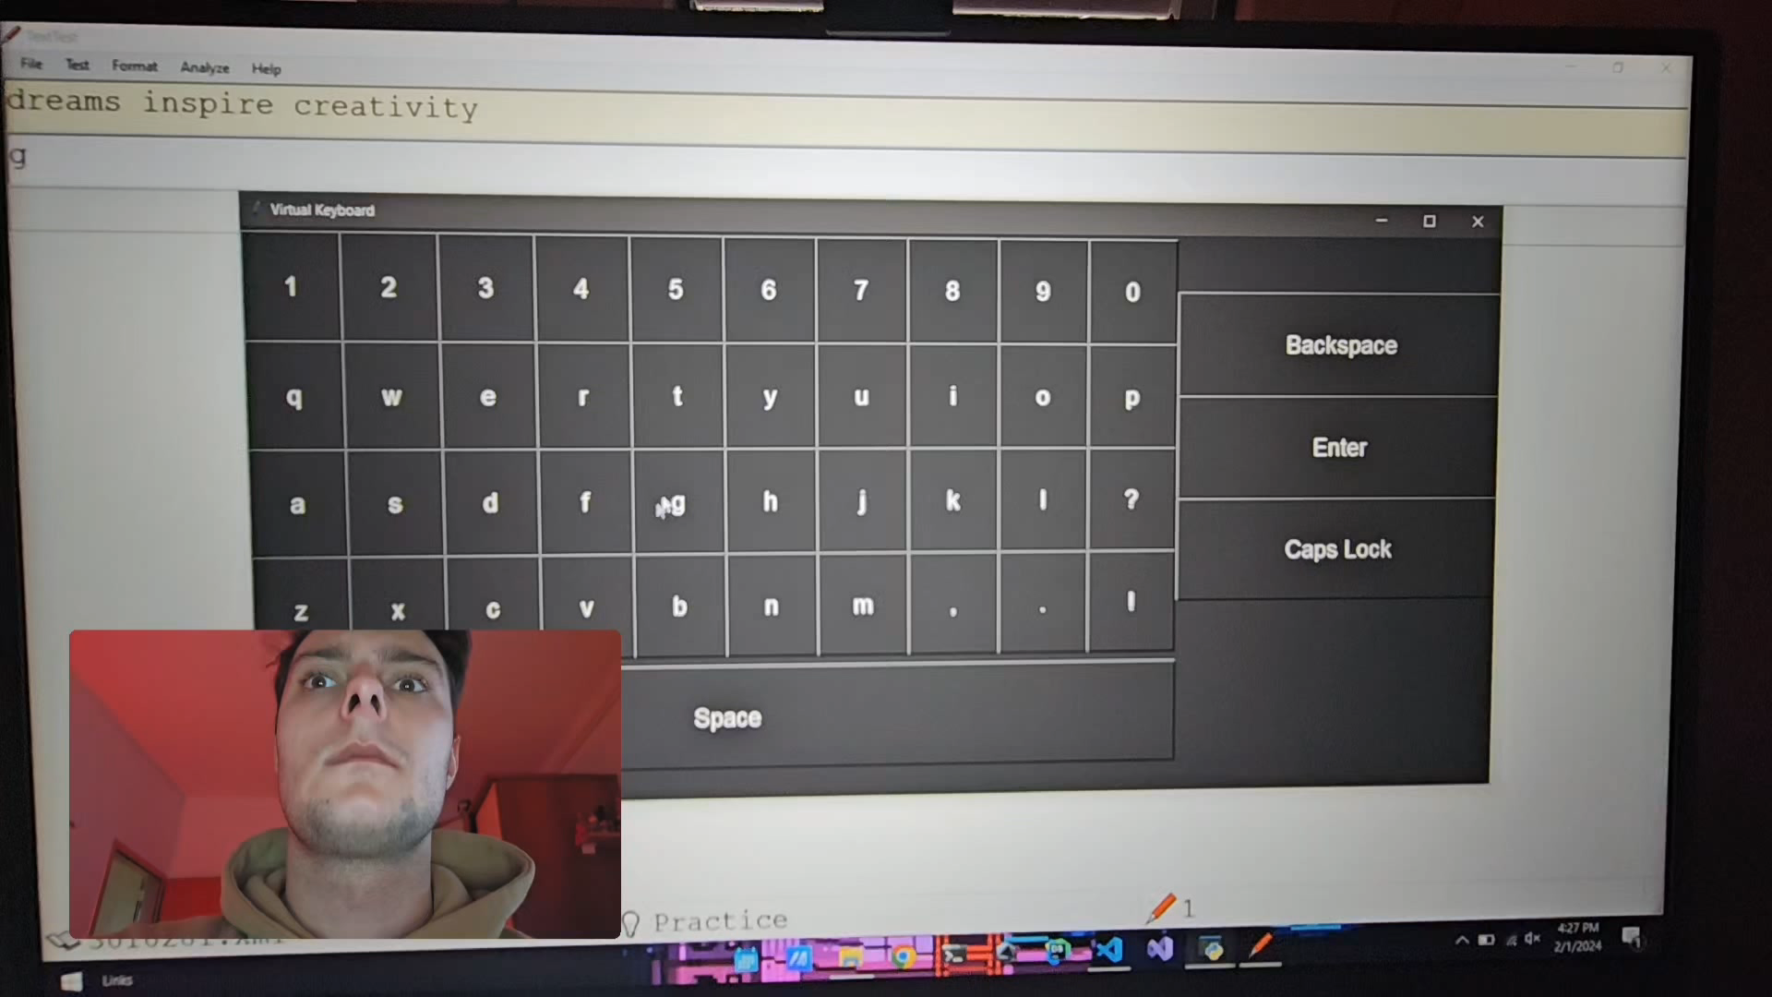
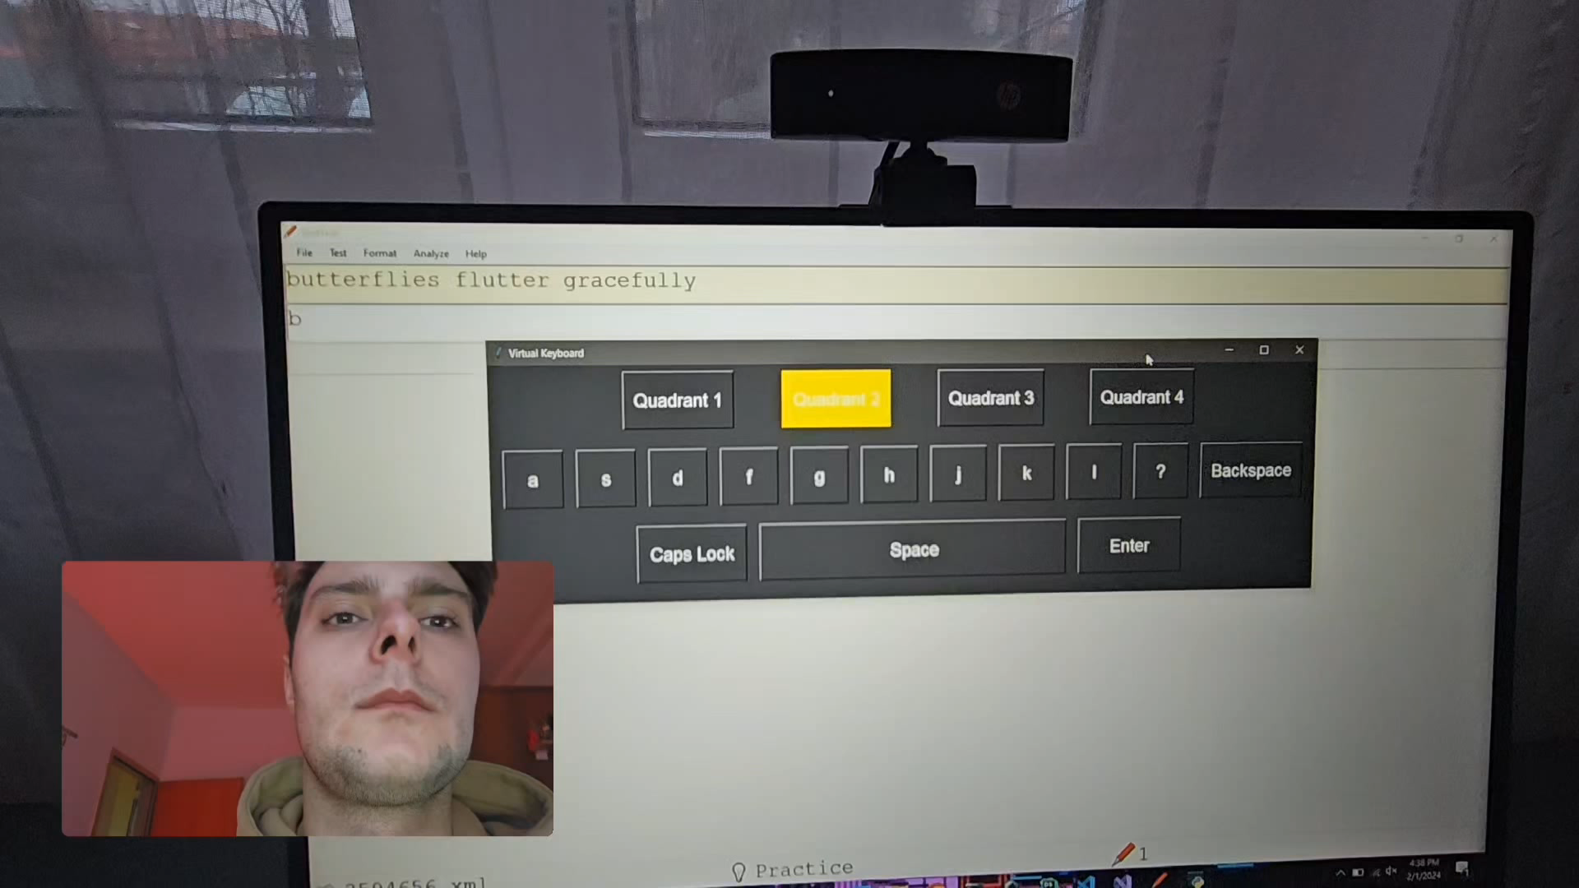
App in action
QWERTY + Free roam
Quadrant + Left-right

Slide 5
Test: step by step
Test rules and steps:
Test participant gets a brief presentation of two ways of input and some guidelines of how to use every keyboard.
Camera is than calibrated to work for specific subject (angle, lighting, position).
Test is initiated .
Test subject is required to enter 3 sentences (each containing 3 words) per test. Sentence pool is 40. 3 test sentences are randomly selected.
Repeat step 3. and 4. until all four tests are done (12 phrases have been written).
Word correction is optional
Test duration (all four tests) averages around 1 hour and 30 minutes
Counterbalancing is done with Latin square (4x4)
Rest between tests is optional
All tests need to be done in ‘one sitting’ to provide most accurate results
Two dependent variables:
WPM (words per minute)
TER (total error rate)
Participant testing, metrics and phrase generating was done using TextTest application.
12 participants: age between 17 and 24 (13 M , 1 F).

Slide 6
NASA Task Load Index (NASA-TLX):
• a widely-used, subjective, multidimensional assessment tool that rates perceived workload to assess a task, system, or team's effectiveness or other aspects of performance.
• 5 factors: mental and physical demand, performance, effort and frustration (no rating of temporal demand)
• Raw TLX
Questionnaire
After the completion of all the test participants were asked to complete a post-study questionnaire.

Slide 7
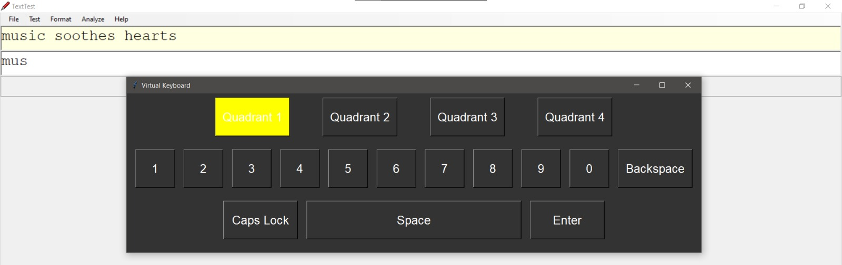
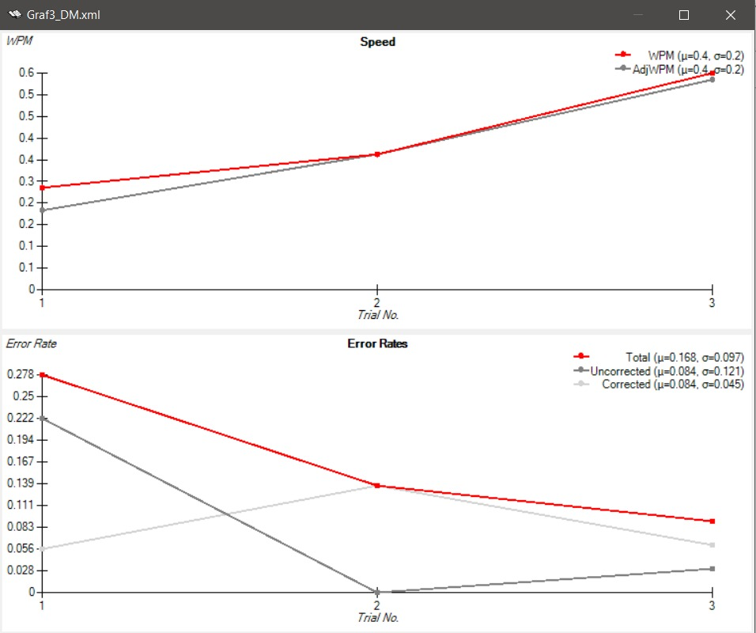

Test: how does it look?
1.
2.
Writing sentences
End of test (after ESC is pressed)
Analise the graph using TextTest and output a csv file (each test forms new csv file)
3.

Slide 8
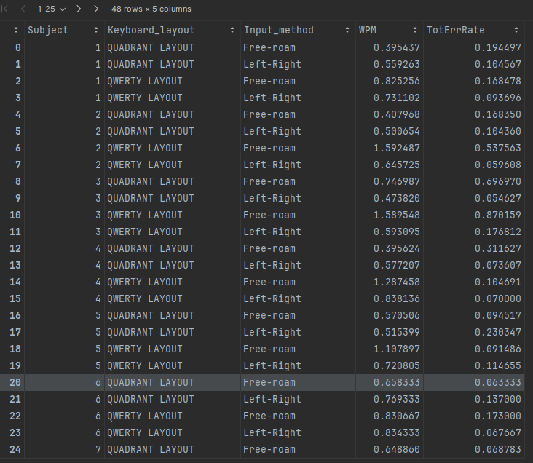
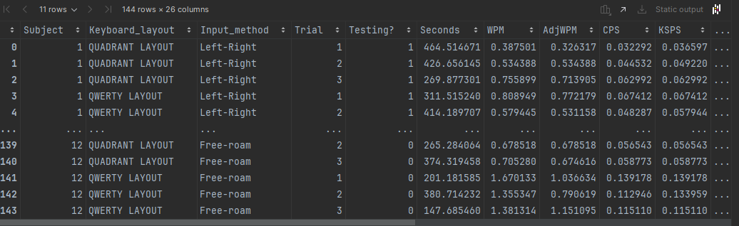
Test Data Analysis: formatting the data
Initial data is grouped by keyboard layout and input method and values of WPM and total error rate on the figure 2 represent the mean values for specific test (one value for each test and each subject)
Figure 1: initial data
Figure 2: grouped data

Slide 9
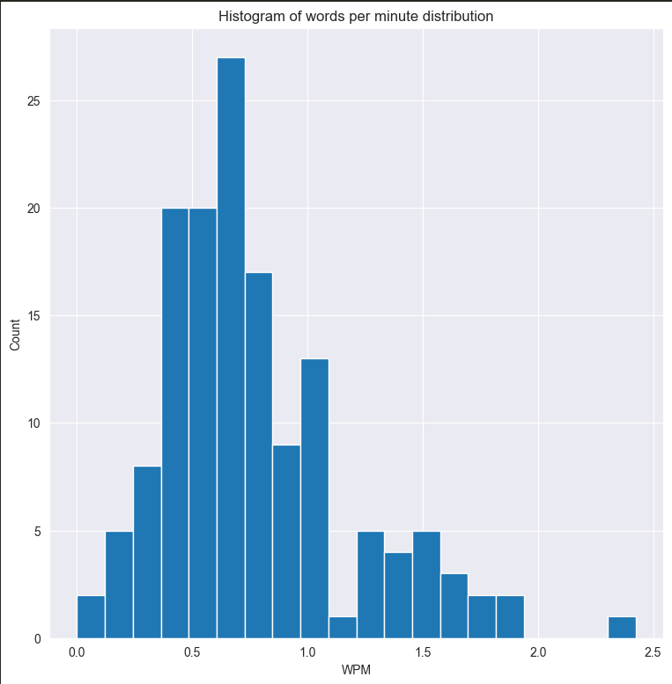
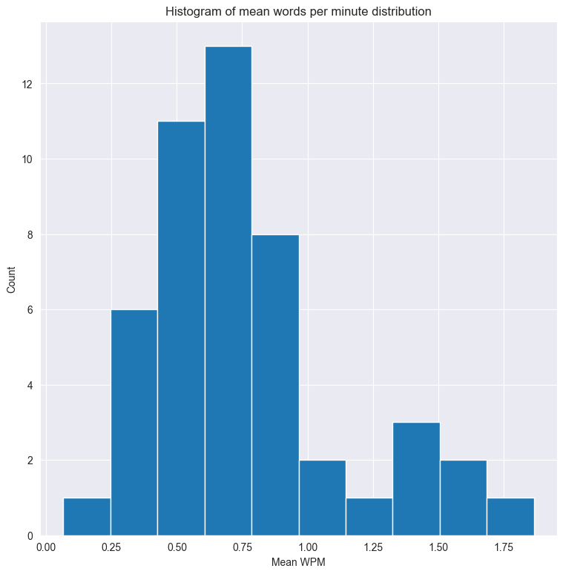
Test Data Analysis: Graphs
Words per minute
Mean words per minute

Slide 10
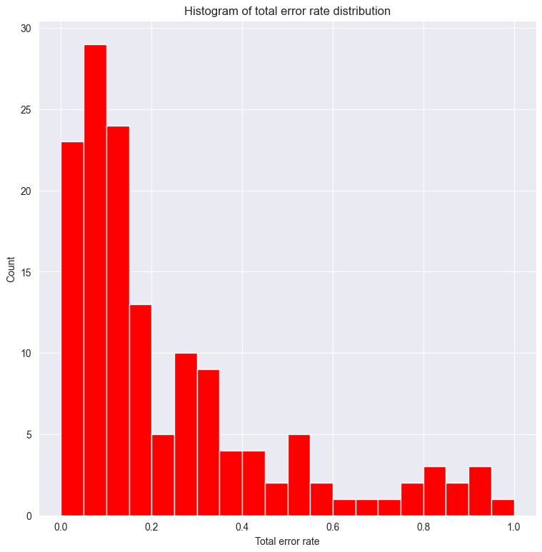
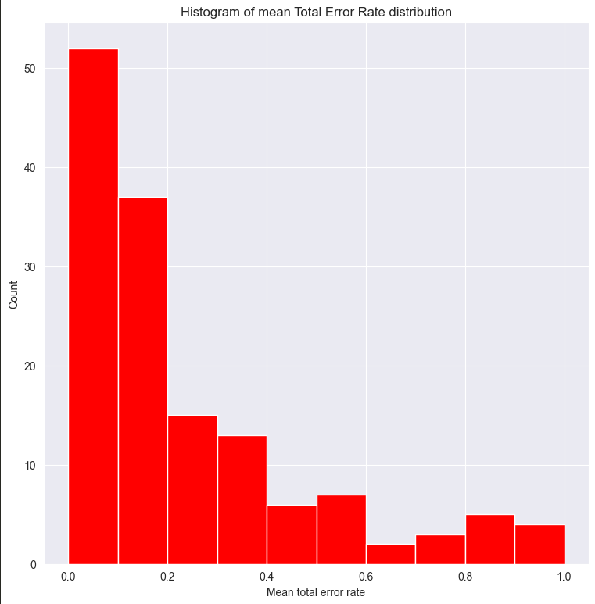
Total error rate
Mean total error rate
1 – (the percent of words that were correctly typed out of the total number of words) = Total error rate

Slide 11
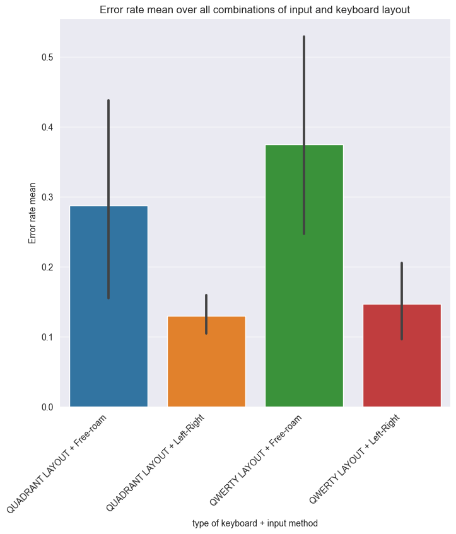
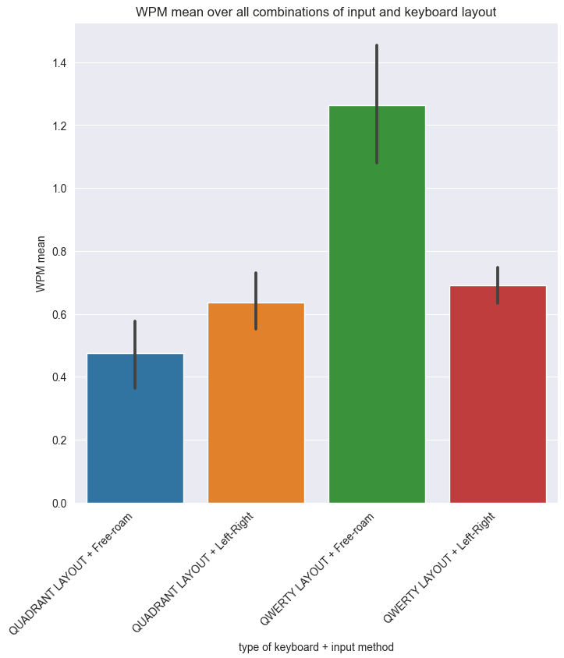
Words
Per
Minute
Mean &
Deviation
Total
Error
Rate
Mean &
Deviation
Both figures serve as a clear representation of WPM or TER means for each combination of keyboard layout and input method. Bar plots show deviations from the mean with lines o top of each bar.

Slide 12
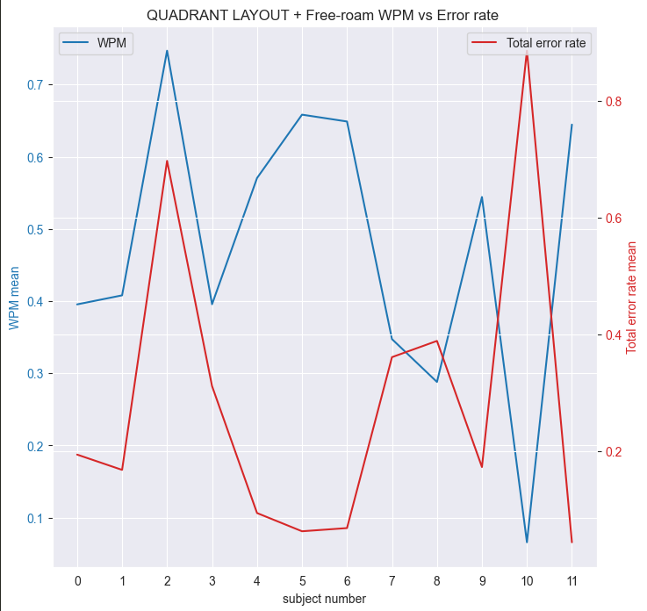
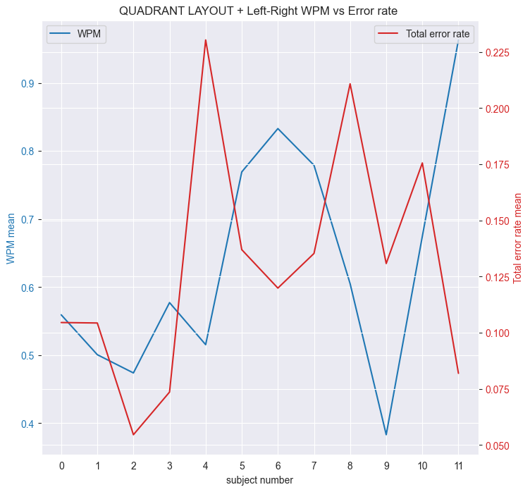
y-axis (blue) -> mean words per minute
y-axis (red) -> mean total error rate
x-axis -> subject number
Q
A
D
R
A
N
T
These graphs show quadrant layout keyboard in combination with free roam or left-right input method and their respective mean WPM and mean TER.

Slide 13
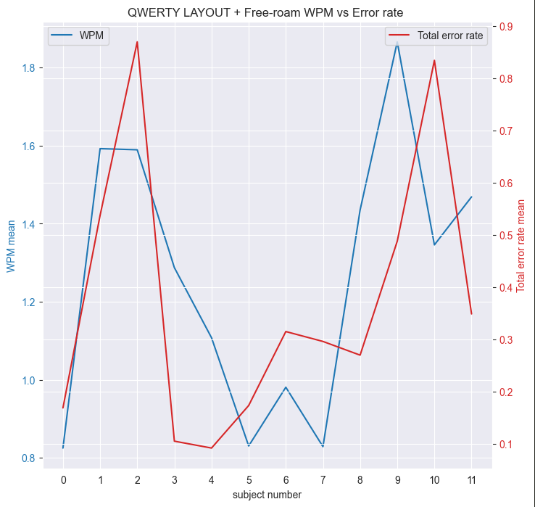
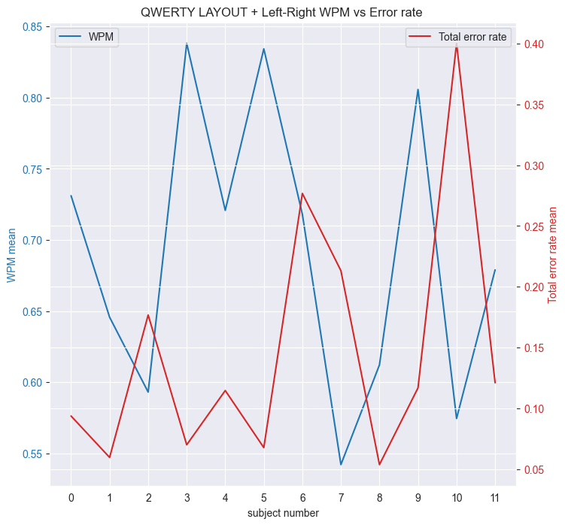
y-axis (blue) -> mean words per minute
y-axis (red) -> mean total error rate
x-axis -> subject number
Q
W
E
R
T
Y
These graphs show qwerty layout keyboard in combination with free roam or left-right input method and their respective mean WPM and mean TER.

Slide 14
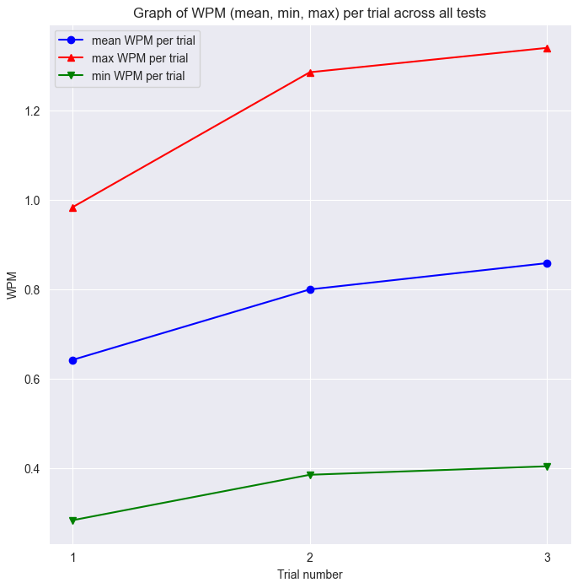
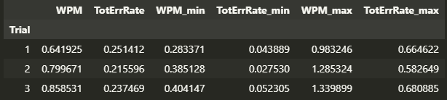
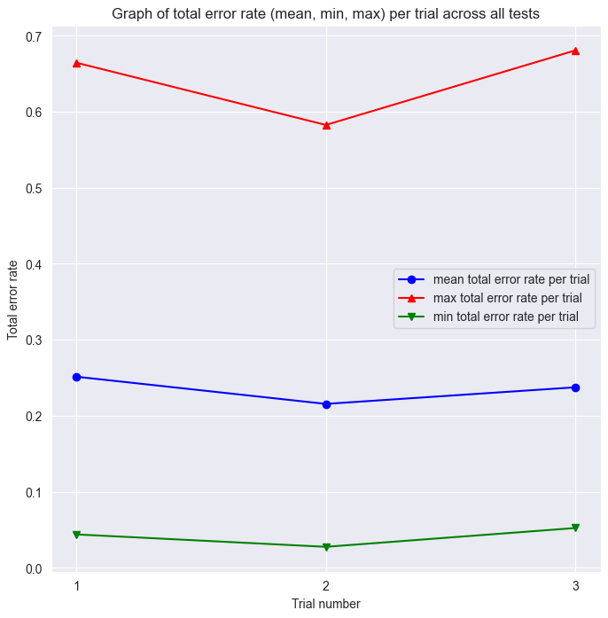
Graph 1 (WPM)
Red -> max
Blue -> mean
Green -> min
Reorganized data and grouped by trials across all combinations of keyboard layouts and all participants.
Shows:
Mean words per minute( graph 1) and mean total error rate ( graph 2)
Minimum words per minute( graph 1) and mean total error rate ( graph 2)
Maximum words per minute( graph 1) and mean total error rate ( graph 2)
Graph 2 (TER)
Red -> max
Blue -> mean
Green -> min

Slide 15
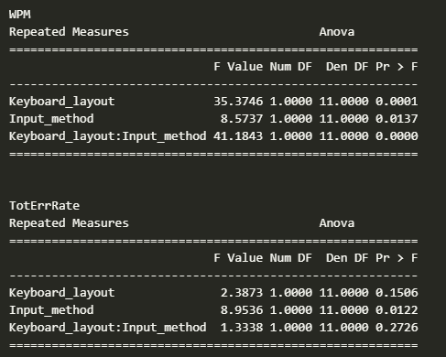
Test Data Analysis: Test results
Repeated measures two way Anova
Words per minute:
Keyboard layout: F(1,11) = 35.3746, p < 0.001
Input method: F(1,11) = 8.5737, p < 0.05
Interaction effect: F(1,11) = 41.1843, p < 0.0001
Test shows significant difference in words per minute between different keyboard layouts, input methods and between different interactions of those two.
Total error rate:
Keyboard layout: F(1,11) = 2.3873, p = 0.1506
Input method: F(1,11) = 8.9536, p < 0.05
Interaction effect: F(1,11) = 1.3338, p = 0.2726
Test shows only significant difference in total error rate between different input methods.

Slide 16
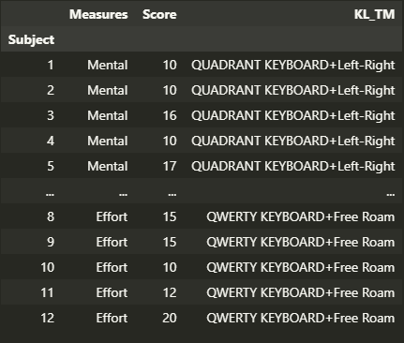
Questionnaire: Data, visualization and test results
Data:
Measures:
Mental demand
Physical demand
Frustration
Performance
Effort
Score – scale from 1 to 21
KL_TM = Keyboard layout + Input method

Slide 17
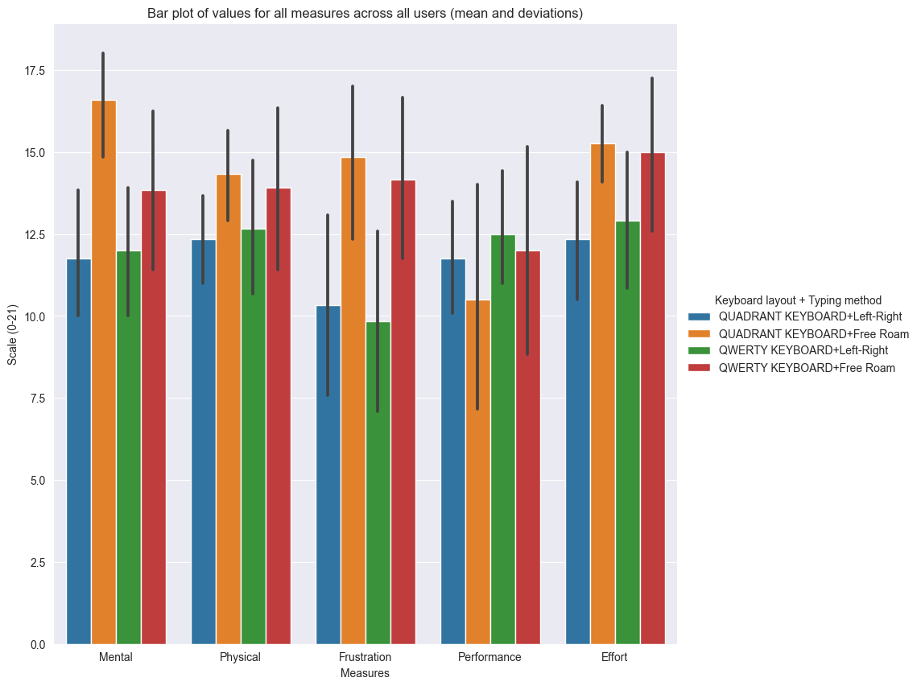
X-axis: Measures (mental and physical demand, frustration, performance, effort)
Y-axis: scale (0-21)
Bar plot shows mean values for every measure score across all users and shows deviations presented as lines on top of every bar plot.

Slide 18
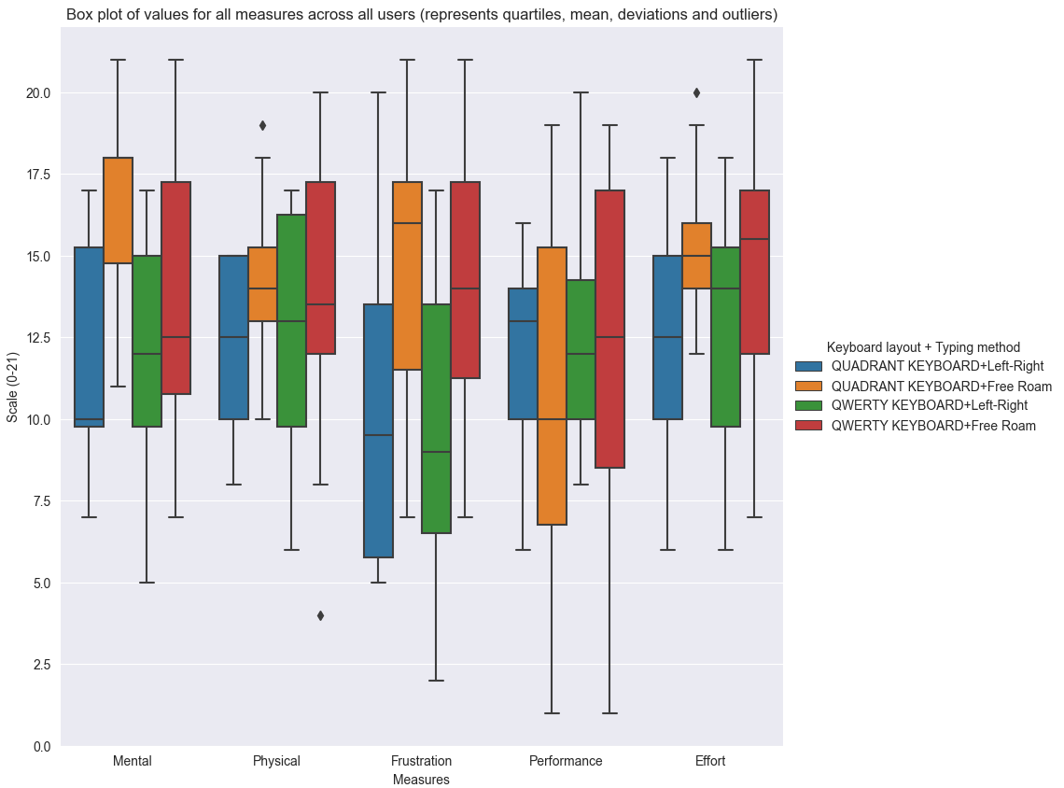
X-axis: Measures (mental and physical demand, frustration, performance, effort)
Y-axis: scale (0-21)
Box plot shows mean values, quartiles, deviations and outliers for every measure score across all users.

Slide 19
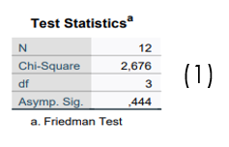
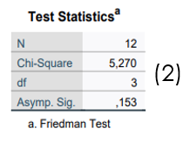
Questionnaire test results
(1) There was NO statistically significant difference in perceived performance depending on which type of text entry method and keyboard layout was used, χ2(3) = 2.676, p = 0.444
(2) There was NO statistically significant difference in perceived physical demand depending on which type of text entry method and keyboard layout was used, χ2(3) = 5.270, p = 0.4153

Slide 20
p < 0.0083 (Bonferroni correction)
Metric: Effort
Pairwise comparison | Test statistics – Wilcoxon
Quadrant + Free roam vs. Quadrant + Left right | Z = -2.673 p < 0.0083
QWERTY + Free roam vs. Quadrant + Left right | Z = -1.583 p = 0.113
QWERTY + Left right vs. Quadrant + Left right | Z = -0.423 p = 0.672
QWERTY + Free roam vs. Quadrant + Free roam | Z = -0.282 p = 0.778
QWERTY + Left right vs. Quadrant + Free roam | Z = -1.737 p = 0.082
QWERTY + Left right vs. QWERTY + Free roam | Z = -1.738 p = 0.082
Test statistics - Friedman
χ2(3) = 8.876
p < 0.05
There was statistically significant difference in perceived effort depending on which type of text entry method and keyboard layout was used, χ2(3) = 8.876, p < 0.05.
Post-hoc analysis was done with Wilcoxon signed-rank tests using Bonferroni correction.
Post hoc analysis with Wilcoxon signed-rank tests and Bonferroni correction applied (p set to 0.0083) did reveal actual significant difference.

Slide 21
p < 0.0083 (Bonferroni correction)
Metric: Frustration
Pairwise comparison | Test statistics – Wilcoxon
Quadrant + Free roam vs. Quadrant + Left right | Z = -2.536 p = 0.011
QWERTY + Free roam vs. Quadrant + Left right | Z = -1.886 p = 0.059
QWERTY + Left right vs. Quadrant + Left right | Z = -0.535 p = 0.593
QWERTY + Free roam vs. Quadrant + Free roam | Z = -1.247 p = 0.212
QWERTY + Left right vs. Quadrant + Free roam | Z = -2.280 p = 0.023
QWERTY + Left right vs. QWERTY + Free roam | Z = -2.162 p = 0.031
Test statistics - Friedman
χ2(3) = 11.920
p < 0.01
There was statistically significant difference in perceived frustration depending on which type of text entry method and keyboard layout was used, χ2(3) = 11.920, p < 0.01.
Post-hoc analysis was done with Wilcoxon signed-rank tests using Bonferroni correction.
Post hoc analysis with Wilcoxon signed-rank tests and Bonferroni correction applied (p set to 0.0083) did not reveal actual significant difference. So it seems that applied correction is too rigorous for this case.

Slide 22
p < 0.0083 (Bonferroni correction)
Metric: Mental demand
Pairwise comparison | Test statistics – Wilcoxon
Quadrant + Free roam vs. Quadrant + Left right | Z = -3.068 p < 0.0083
QWERTY + Free roam vs. Quadrant + Left right | Z = -1.157 p = 0.247
QWERTY + Left right vs. Quadrant + Left right | Z = -0.416 p = 0.677
QWERTY + Free roam vs. Quadrant + Free roam | Z = -1.785 p = 0.074
QWERTY + Left right vs. Quadrant + Free roam | Z = -2.556 p = 0.011
QWERTY + Left right vs. QWERTY + Free roam | Z = -1.159 p = 0.246
Test statistics - Friedman
χ2(3) = 15.027
p < 0.01
There was statistically significant difference in perceived mental demand depending on which type of text entry method and keyboard layout was used, χ2(3) = 15.027,
p < 0.01.
Post-hoc analysis was done with Wilcoxon signed-rank tests using Bonferroni correction.
Post hoc analysis with Wilcoxon signed-rank tests and Bonferroni correction applied (p set to 0.0083) did reveal actual significant difference.

Slide 23
Conclusion
In general:
Statistical tests show that there is a significant difference in words per minute and error rate depending on what keyboard layout and input method participant uses
Test shows that there is significant difference between words per minute mean when comparing usage of different keyboard layouts
Test show that there is significant difference between total error rate mean when comparing usage of different input methods
Freidman’s test shows significant difference in perceived effort, frustration and mental demand between all participants, but Wilcoxon signed-rank test shows no actual significant difference for frustration among users

Slide 24
Thank you!
Questions ?

